Slide 1

Web Development Foundations
01
Web Fundamentals & The Developer’s Toolkit

Slide 2
What Happens in an Internet Minute?
694 Million
$43.6 Million
6.3 Million
231 Million
Spotify Streams
Spent Online
Google Searches
Emails Sent
Source: BondHighPlus (2025), Forbes (Domo Data Never Sleeps), CompareInternet, Statista
Notes:
Narrative: "Everything you see every bank transaction, every social media post, every news article—is built on the foundation we are starting today. You aren't just learning to code; you are learning to build the infrastructure of modern society."

Slide 3

Meet your Lead Developer (Instructor)
Midhun Harikumar
Always Exploring New Technologies
Engineering Manager
17 Years of Industry Experience
Full Stack Developer
UI UX & Modern Web Tech
Tech Enthusiast
Android Developer
midhunhk.com github.com/midhunhk linkedin.com/in/midhunhk/

Slide 4

Who is in the Room?
Type in the chat:
One word describing your goal.
Your favorite website.
One thing you hope to build by Session 10.
Photo By Vladislav Klapin on Unsplash.com

Slide 5
Part 1: How the Web Works

Slide 6
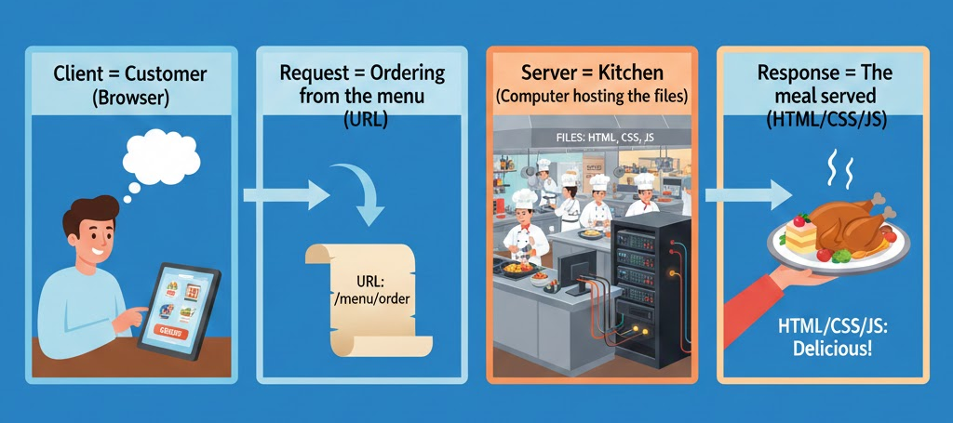
The Client-Server Model
Source: Gemini

Slide 7

The Client-Server Model
Source: Wikipedia.com

Slide 8
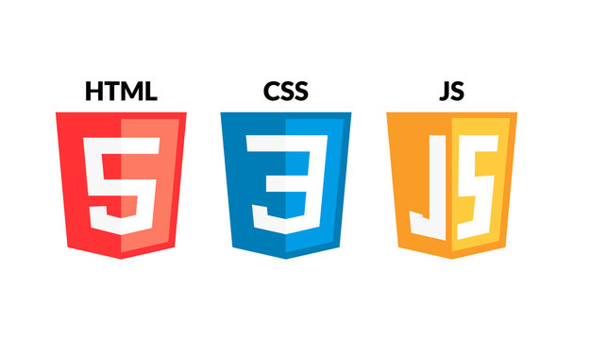
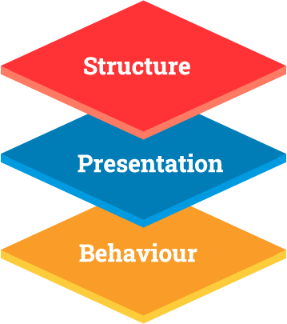
HTML, CSS and Javascript
Notes:
HTML: The Skeleton (Structure).
CSS: The Skin/Clothes (Presentation).
JavaScript: The Muscles/Brain (Behavior).

Slide 9
Demo on codepen.io
<button>Hello</button>
button {
background-color: aqua;
color: white;
font-size:20px;
border-radius:50px;
padding:10px;
}
let button = document.querySelector('button');
button.addEventListener('click', () => {
console.log('button clicked');
});
https://codepen.io/magnetik-works/pen/MYeKger

Slide 10
Part 2: The Environment Setup
Install Visual Studio Code
Install recommended extensions
Install Git tools
Create accounts on
Github.com
Netlify or Vercel
CodePen.io

Slide 11
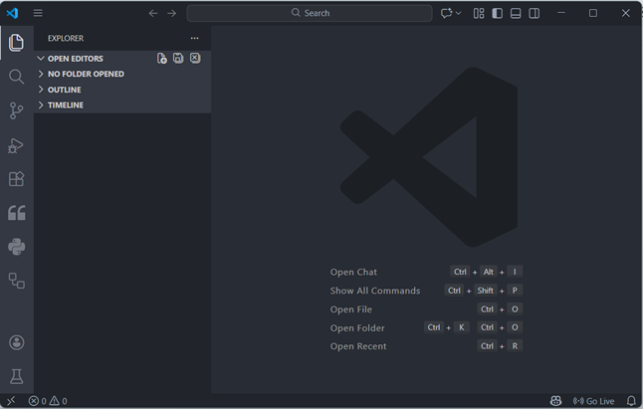
Visual Studio Code and Extensions
Live Server: Launches a local development server with a live reload feature (see changes as soon as you save).
Prettier - Code Formatter: Automatically cleans up code indentation and styling.
Auto Close Tag / Auto Rename Tag: Saves time by managing HTML tags automatically.
ESLint: Points out JavaScript errors in real-time before the code is even run.
Thunder Client: Optional extension to be able to test API responses outside of the browser.

Slide 12
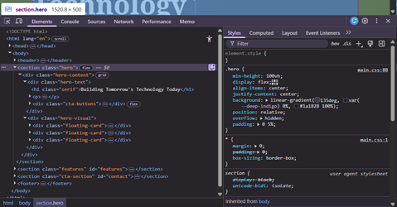
Browser DevTools
Navigate to your Favourite website
Right click and select “Inspect” or Press F12
Go to the “Elements” tab to see the HTML structure of that page
Use Device Toolbar to test on different screen sizes
Inspect the styles of a component

Slide 13
10
Minute Break

Slide 14
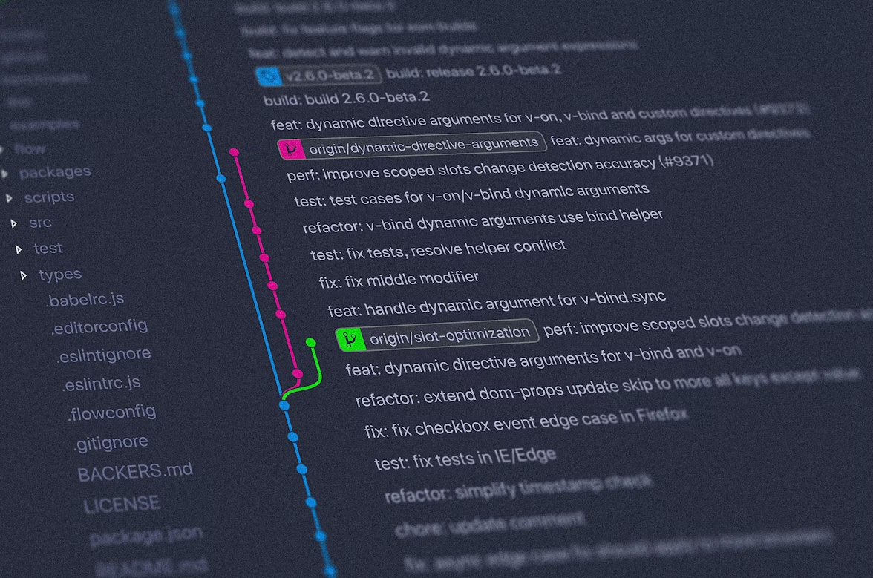
Part 3: Version Control with Git & GitHub
Concept: Git is like a "Save Point" system (like a video game) for code. It is currently the industry standard “Source Code Management” (SCM) tool
Git vs. GitHub:
Git: Local tool (on your machine).
GitHub: Cloud storage (social media for code).
Source: Yancy Min on Unsplash.com

Slide 15
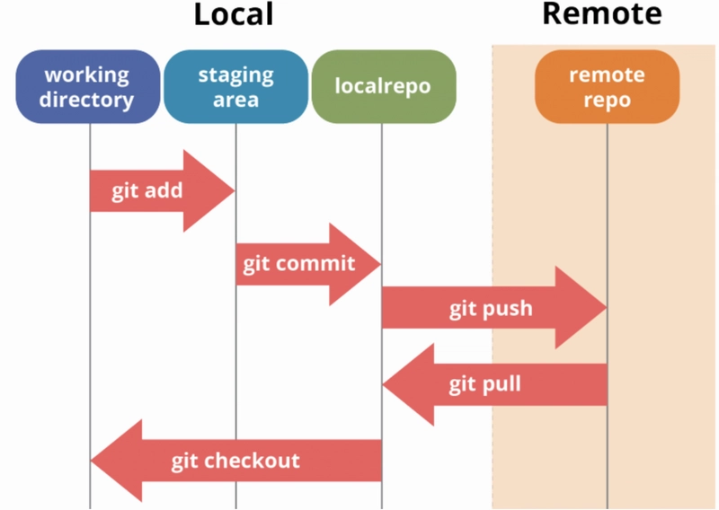
Git Workflow - Commands
Basic Commands
git init (Start tracking)
git add . (Stage changes/Prepare to save)
git commit -m "message" (Save point)
git push (Upload to cloud)
Source: Dev.to

Slide 16
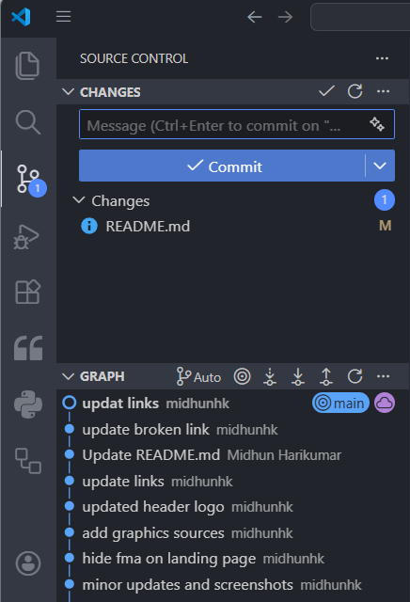
Git Workflow - User Interface
Same can be used with the help of Plugins in Visual Studio Code

Slide 17
Lab
Objective: Create a personal "landing page" repo.
We will:
Create a new folder
Open it in VS Code
Create an “index.html”
Add HTML Skeleton code
Add a “Hello World” title with your name
Initialize a Git repository
Add your project files and commit it
Submit the repository link in the Module 3 Quiz after completing the Module 2 Lab

Slide 18
Additional Activities
Complete the Lab if you have not been able to yet
Research
Look up Semantic HTML vs Non Semantic HTML and bring an example to the next class
Watch a short video on “How DNS works”
Learn markdown syntax for adding notes or issues in your projects
Practice
Spend some time to customize the themes and settings on VS Code and personalize them to your comfort.

Slide 19
Summary
1. The Core Stack
HTML: The Structure (What is on the page?) CSS: The Style (How does it look?) JavaScript: The Logic (What does it do?)
Client-Server Model: Understanding how the browser (Client) requests data and the Server sends back the files (HTML/CSS/JS).
2. Your Professional Toolkit
Editor: VS Code Debugger: Browser DevTools Version Control: Git (Tracking history) & GitHub (Collaboration and Hosting).
3. The "Pro" Workflow
Write code in VS Code. Preview with Live Server. Inspect with DevTools. Save with git commit. Sync with git push to GitHub.

